Slide 1
Differential diagnosis for diarrhoea, dysentery & tenesmus in large animals

Slide 2
Definition
Diarrhoea reffers to
An increase in the fluid content of feces
An increase in the amount of feces produced
An increase in the frequency of defeacation
Dysentery is bloody dhea

Slide 3
Diarrhoea in young calves and lambs
Colibacillosis – 1st week of life
Corona virus & Rotaviruses – commonest cause of voluminous dhea in neonates
Cryptosporidium parvum- common cause of dhea in neonates
Coccidia – blood in feces and tenesmus in calves >2 mo <1yr reared in congested premises

Slide 4
Clostridium perf. A, B, C – fatal hemorrhagic diarrhea in calves; B & C cause enteritis & dysentery in lambs
Salmonellosis (S.typhimurium & dublin) – enteritis with septicaemia in neonates up to 1wk of age, usually due to insufficient immunity – depression with high fever & death in 24–48 hr. Nervous signs and pneumonia may be seen in calves and pigs. Mortality may reach 100%

Slide 5
There is severe watery diarrhea with foul smell, mucus, fibrinous casts, shreds of mucus membranes, sometimes dysentery, and often tenesmus
Helminthosis – anemia & bottle-jaw, rough haircoat
Prolonged antibiotic therapy- history of prolonged medication
Calves fed large amounts of milk or inappropriately formulated milk replacers produce a large volume of fluidy feces

Slide 6
Causes of diarrhea in adults
Salmonellosis – Acute enteritis without extensive systemic involvement is more common in adults & young animals ≥1 wk old. severe watery diarrhea, sometimes dysentery, and often tenesmus. Feces have a putrid odor and contain mucus, fibrinous casts, shreds of mucous membrane, and in some cases, blood.
In chronic dse, dhea is intermittent & may be accompanied by abortions.
-

Slide 7
BVD – May be inapparent or acute and severe enteric disease to the highly fatal mucosal disease complex characterized by profuse enteritis in association with typical mucosal lesions.
MCF – fever, enlarged LNs, lesions on the muzzle, eyes, oral cavity and feet. Associated with sheep & wildbeests

Slide 8
Rinderpest – oral & feet lesions, dysentery, high morbidity & mortality - has been eradicated world wide but an important ddx for FMD, BVD & MCF etc.
Organophosphate poisoning – history of exposure, xsive salivation, sweating, vomiting & CNS signs
Indigestion and grain overload – history of exposure/change of feed

Slide 9
Johne’s disease – projectile odorless dhea in cows >2yrs usually after calving, progressive emaciation & bottle-jaw
Molybdenosis – persistent debilitating dhea, signs of 2º hypocuprosis (wt loss, haircoat depigmentation & anemia)
Lead poisoning – CNS signs
Alimentary tract tumors

Slide 10
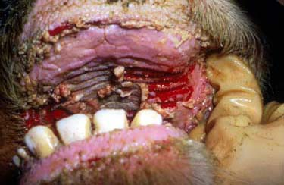
Remember to read
Rinderpest
M.C.F.
Johne’s dse
Poisoning-Lead, Arsenic, Bracken fern e.t.c.
Oral lesions like in FMD, MCF, rinderpest etc.

Slide 11
Tenesmus
Tenesmus means straining during defecation.
Some of the causes are
Constipation
Rectal conditions such as paralysis, stenosis and tears
Lower urinary tract diseases
Genital tract diseases

Slide 12
Tenesmus
-Lacerations of the mucocutaneous junction of the anus
Intestinal torsion and volvulus
Lower spinal cord lesions
Colic – especially in horses
Poisoning eg. lead poisoning

Slide 13
CONSTIPATION
Caused by severe debility as in old age
Chronic dehydration
Partial large intestinal obstruction
Painful anal conditions
Paralytic illeus
Chronic illness in horses
Anaplasmosis in cattle
Chronic zinc poisoning in cattle
Low roughage diets
Terminal stages of pregnancy in cattle

Slide 14
RECTAL STENOSIS
Can be caused by chronic salmonellosis in cattle And enteric salmonellosis in pigs
C/S-Progressive abdominal distension, inappetance and passage of watery to pasty feaces

Slide 15
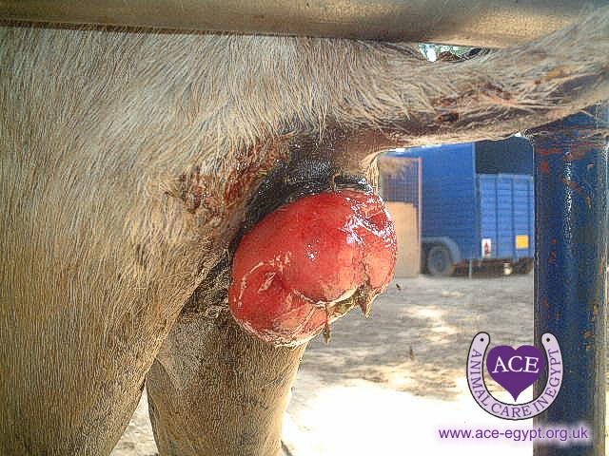
LOWER GIT CONDITIONS
Coccidiosis and chronic salmonellosis
Rectal prolapse

Slide 16
GENITAL TRACT DISEASES
Vaginitis
Urethral obstruction
Retained afterbirth
Vaginal tears during difficult calving

